Slide 1

VE496 Advanced Technical Communication
Week 12, Day 1:
Public Speaking Core Skills
Nathaniel T. Murray 莫子禅
Summer 2020

Slide 2
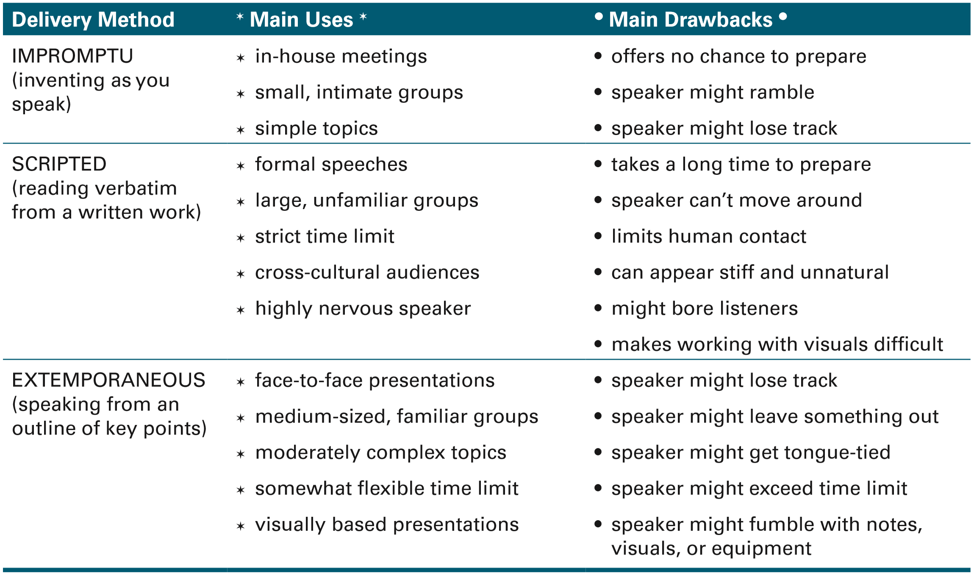
Types of Speeches
Lannon & Gurak (2018)

Slide 3
Speaking Purposes
Inform | Describe objective facts, cite specific sources of information
Instruct | List out learning outcomes at the start, provide instructions that audience can take away
Persuade | Describe what the situation is first, then explain how your proposition is the best answer to it
Call to action | Explain why other options are not feasible, use strong action words for what should be done
Sell a product | Describe the customer’s problem, then how your product is the solution to it

Slide 4
Categories of Talks
Article Talk | For presenting conference papers. Begin with background, problem you’re addressing, how it is tied to previous research. State results without going into much detail, or at least selective detail. Do not use too much jargon, in case non-specialists attend your session.
Survey Talk | For guest lectures. Research your subject thoroughly, and provide audience with list of references. Redirect questions you don’t know the answer to, saying that it is outside the scope of the talk. Provide a synthesis of concepts in the field.
Interview Talk | For job or professional interviews. Focus on a specific topic, aiming your talk at mid-level professionals, but prepared to discuss simpler or more advanced concepts. If you do not know an answer, say you are still researching it, or redirect to a topic you know.

Slide 5
Public Speaking Skills
Body language
Intonation
Structure
Incorporating visuals
Group interaction

Slide 6
Body Language
Body posture
Hand and eye motions
Moving around the stage

Slide 7
Intonation
Extended pauses
One-word “punch”
Suspense and release
Varying sentence lengths
Rise and fall: shaping and separating phrases
Nate’s personal favorite: changing up the voices

Slide 8
Structure
Opening “hook”
Main theme introduced
Body: supporting arguments or narratives
Tying the arguments/narratives back to main theme
Ending with a call to action

Slide 9
Archaeology from Space
Opening story: sand dollars on the beach
Expansion: small beach to large Egyptian delta
Types of visual aids
Satellite imagery
Personal photographs
Stock footage (for demonstration purposes, e.g. jewelry)
Core value: sharing knowledge and training young engineers
Ending quote – from the Middle Kingdom period itself
Literary technique: 1984
Back to the beginning: sand dollars on the beach

Slide 10
8 Secrets for Success
Opening story: teenager’s question
Two-step delivery: (1) the secret → (2) supporting quotations
Interjections: “Did he say fun? Rupert? Yes!”
Visual aids:
Photographs
Cartoonish diagrams (some with entry animations)
Humor technique: mother in a tow truck
Ending: acknowledging TEDsters for giving him their time

Slide 11
Open-Sourced Blueprints for Civilization
Opening juxtaposition: “farmer, technologist”
Technique of integrating visuals into speech: “tractors, bread ovens, circuit makers” → fast cycle through the rest of the machines
Visual side-by-side comparison: Theirs vs. Ours
Types of visuals
Diagrams of machines
Photographs of him building and operating them
Stock footage (for humor purposes, i.e. the cramped chalkboard)
Development story
Innovation: use of open source for hardware, not software
Core value: unleashing human potential

